Slide 1
Creating Graphics Using Variables
Notes:
Hi! In this lesson, we’re going to look at how we can use variables to size and position graphics in our Python graphics program. But first, why is this important?

Slide 2
Why use Variables in Graphics?
To write cleaner program that are easier to read and debug
To have one program output look the same for any canvas value
To easily resize/reposition items
Notes:
Using variables in place of static values in our graphics programs give the same benefits as using variables in our console programs. First, variables allow our code to be cleaner and easier to debug because the variable names describe their use. In our graphics programs, variables allow the output from one program to be positioned and sized the same way regardless of a changing canvas size and allows us to resize and reposition items efficiently and effectively. Now let’s see how to do this!

Slide 3
Flag of Japan
To create an oval/circle:
screen.create_oval(top left x, top left y, bottom right x, bottom right y)
(100, 50)
Constant Values:
canvas_width = 400
canvas_height = 300
circle_radius = 100
(300, 250)
Notes:
In the last lesson, we created the flag of Japan using the top left and bottom right coordinates of the circle that were determined based on the constant values we were given.

Slide 4
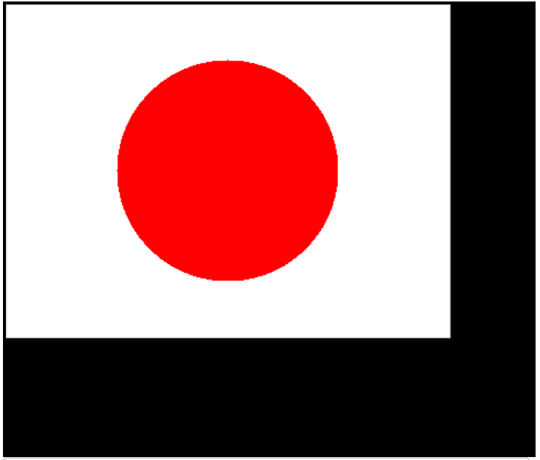
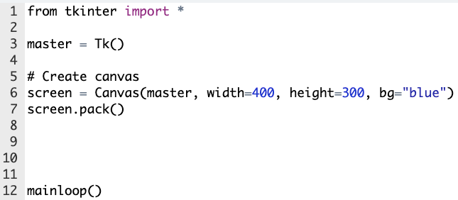
Flag of Japan
from tkinter import *
root = Tk()
# Create canvas
screen = Canvas(root, width=400, height=300, bg="white")
screen.pack()
screen.create_oval(100, 50, 300, 250, fill="red", outline="")
mainloop()
Notes:
When we run this program, we see that the flag looks as we intended. But if the size of our canvas changes...

Slide 5
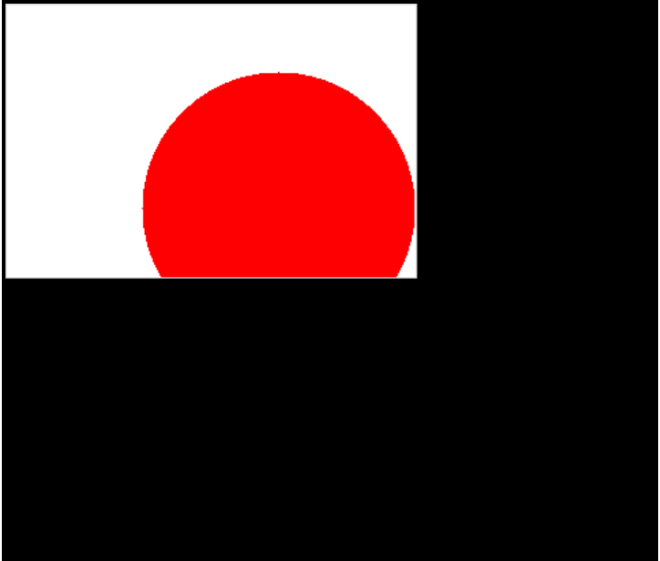
Flag of Japan
from tkinter import *
root = Tk()
# Create canvas
screen = Canvas(root, width=300, height=200, bg="white")
screen.pack()
screen.create_oval(100, 50, 300, 250, fill="red", outline="")
mainloop()
Notes:
...our circle is no longer centered on our flag. If we use variables instead of static values to size and position our circle, we can have a program that looks as intended no matter the canvas dimensions. Let’s see how to do this.

Slide 6
Flag of Japan using Variables
To create an oval/circle:
screen.create_oval(top left x, top left y, bottom right x, bottom right y)
Constant Values:
canvas_width = ??
canvas_height = ??
circle_radius = ??
Notes:
If we no longer know the values of our constants, we can simply use the variables in their place! Let’s first look at finding the x-coordinate of the top left point.

Slide 7
Flag of Japan using Variables
To create an oval/circle:
screen.create_oval(top left x, top left y, bottom right x, bottom right y)
canvas_width
Circle Coordinates:
Top Left Corner:
x:
y:
Bottom Right Corner:
x:
y:
Notes:
We can now use the variable ‘canvas_width’ to represent the entire canvas length.

Slide 8
Flag of Japan using Variables
To create an oval/circle:
screen.create_oval(top left x, top left y, bottom right x, bottom right y)
canvas_width/2
Circle Coordinates:
Top Left Corner:
x:
y:
Bottom Right Corner:
x:
y:
Notes:
Which means that half of this length would just be canvas_width/2.

Slide 9
Flag of Japan using Variables
To create an oval/circle:
screen.create_oval(top left x, top left y, bottom right x, bottom right y)
canvas_width/2
Circle Coordinates:
Top Left Corner:
x: canvas_width/2 - circle_radius
y:
Bottom Right Corner:
x:
y:
circle_radius
Notes:
If we subtract the value of circle_radius, we’ll find the x coordinate of that point, no matter what the actual numbers are.

Slide 10
Flag of Japan using Variables
To create an oval/circle:
screen.create_oval(top left x, top left y, bottom right x, bottom right y)
Circle Coordinates:
Top Left Corner:
x: canvas_width/2 - circle_radius
y:
Bottom Right Corner:
x:
y:
canvas_height
Notes:
Now let’s figure out the y position of this point. We can now use the variable ‘canvas_height’ in place of a static value...

Slide 11
Flag of Japan using Variables
To create an oval/circle:
screen.create_oval(top left x, top left y, bottom right x, bottom right y)
Circle Coordinates:
Top Left Corner:
x: canvas_width/2 - circle_radius
y:
Bottom Right Corner:
x:
y:
canvas_height/2
Notes:
Which means that half of this height would just be canvas_height/2.

Slide 12
Flag of Japan using Variables
To create an oval/circle:
screen.create_oval(top left x, top left y, bottom right x, bottom right y)
Circle Coordinates:
Top Left Corner:
x: canvas_width/2 - circle_radius
y: canvas_height/2 - circle_radius
Bottom Right Corner:
x:
y:
canvas_height/2
circle_radius
Notes:
If we subtract the value of circle_radius, we’ll find the y coordinate of that point is half the canvas_height minus the radius of the circle.

Slide 13
Flag of Japan using Variables
To create an oval/circle:
screen.create_oval(top left x, top left y, bottom right x, bottom right y)
canvas_width/2
Circle Coordinates:
Top Left Corner:
x: canvas_width/2 - circle_radius
y: canvas_height/2 - circle_radius
Bottom Right Corner:
x: canvas_width/2 + circle_radius
y:
circle_radius
Notes:
To find the x-coordinate of the bottom right point, we follow the same steps but instead of subtracting the radius of the circle, we add it to half the canvas_width.

Slide 14
Flag of Japan using Variables
To create an oval/circle:
screen.create_oval(top left x, top left y, bottom right x, bottom right y)
Circle Coordinates:
Top Left Corner:
x: canvas_width/2 - circle_radius
y: canvas_height/2 - circle_radius
Bottom Right Corner:
x: canvas_width/2 + circle_radius
y: canvas_height/2 + circle_radius
canvas_height/2
circle_radius
Notes:
And to find the y-coordinate of the bottom right point, we add the circle_radius to half the canvas_height. Let’s see this in the editor.

